Slide 1
NavDrive : Next-gen Automated Vehicle Driving with Real-time Intelligent Vision and Engineering A Self Driving car Project
Project title :

Slide 2
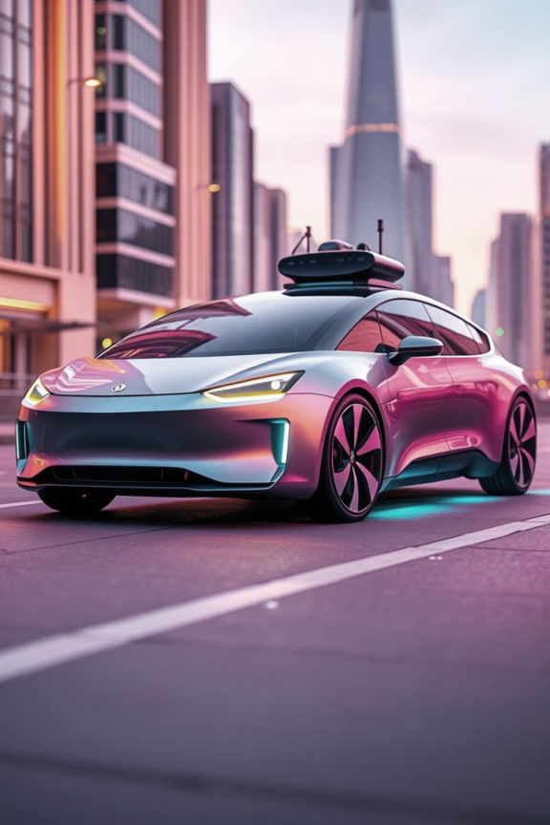

Introduction
A self-driving car project designed to simulate autonomous vehicle functionality using Raspberry Pi, Arduino , sensors for navigation.
The Autonomous Car Project aims to develop a self-driving vehicle capable of navigating roads safely and efficiently without human intervention. This revolutionary technology has the potential to transform transportation, improve road safety, and reduce environmental impact.

Slide 3

Objectives
The primary objective of the NavDrive project is to design and develop a low-cost, smart autonomous car that can navigate its environment without human intervention. This system aims to:
Implement self-driving capabilities using sensor-based perception instead of LiDAR or radar.
Enable real-time decision-making through integration of Arduino and Raspberry Pi.
Provide a foundation for future enhancements such as advanced navigation, object detection, and AI-based driving logic.

Slide 4
Different Stages :
Data Acquisition
Sensor Fusion
Decision-Making
Algorithms combine and cross-reference data from sensors to create a comprehensive understanding of the environment.
The system analyzes the sensor data, and plans the optimal driving trajectory.
Sensors continuously gather real-time data about the vehicle's surroundings.

Slide 5
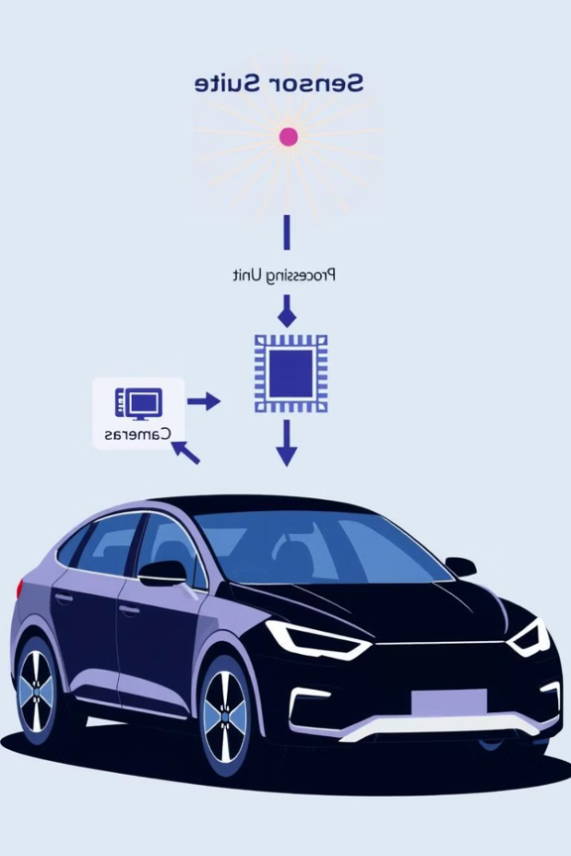
Hardware Components
Arduino: Controls motors, Serial Communication
Arduino Shield : Connecting the components - .
Raspberry Pi: Processes data, controls autonomy logic, future scope for AI.
Raspberry Pi Camera : For Taking Images , Photos
Motor Driver (L293N): Drives the motors based on Arduino commands.
CT6B Transmitter/Receiver: Sends manual control inputs during Data Collection

Slide 6
Hardware Components
BO Motors : To run the Project SG90 Servo Motor : Steer the motors
LM2596(Buck Converter ) : Buck Converter For powering the Arduino
XL6009 (Boost Module) : To power the Raspberry Pi
18650 (Li-ion) Cells : To give power to XL6009
Battery (11.1V 3S): Powers the system.

Slide 7

Software & IDE’s
Arduino IDE (CPP)
Raspberry Pi OS
Python (For Raspberry Pi processing and automation scripts)
Python Libraries:
pySerial (for serial communication)
time, math (for sensor data handling)
Threading (for Running Code in Parallel )
OpenCV
Tenserflow Lite
Pipelines

Slide 8





Core Technology: Behavior Cloning
Mimicking Human Driving
Machine learning technique replicates human driving behavior.
Training Data
Collected from human driving sessions, ensuring realistic responses.
Input
Sensor data includes camera Photos
Output
Steering angle and vehicle speed are the direct outputs.

Slide 9
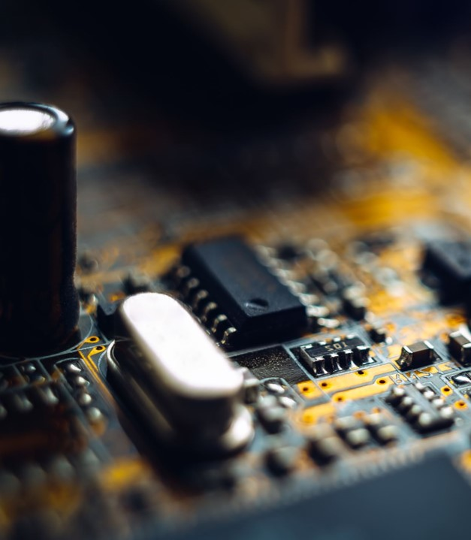
Machine Learning Model
Model Architecture
Convolutional Neural Network (CNN) forms the core.
Input Layer
Images from front-facing camera (640x480 pixels) And Sterring Angle (Normalized)
Output Layer
Steering angle (Normalized)) are predicted.

Slide 10
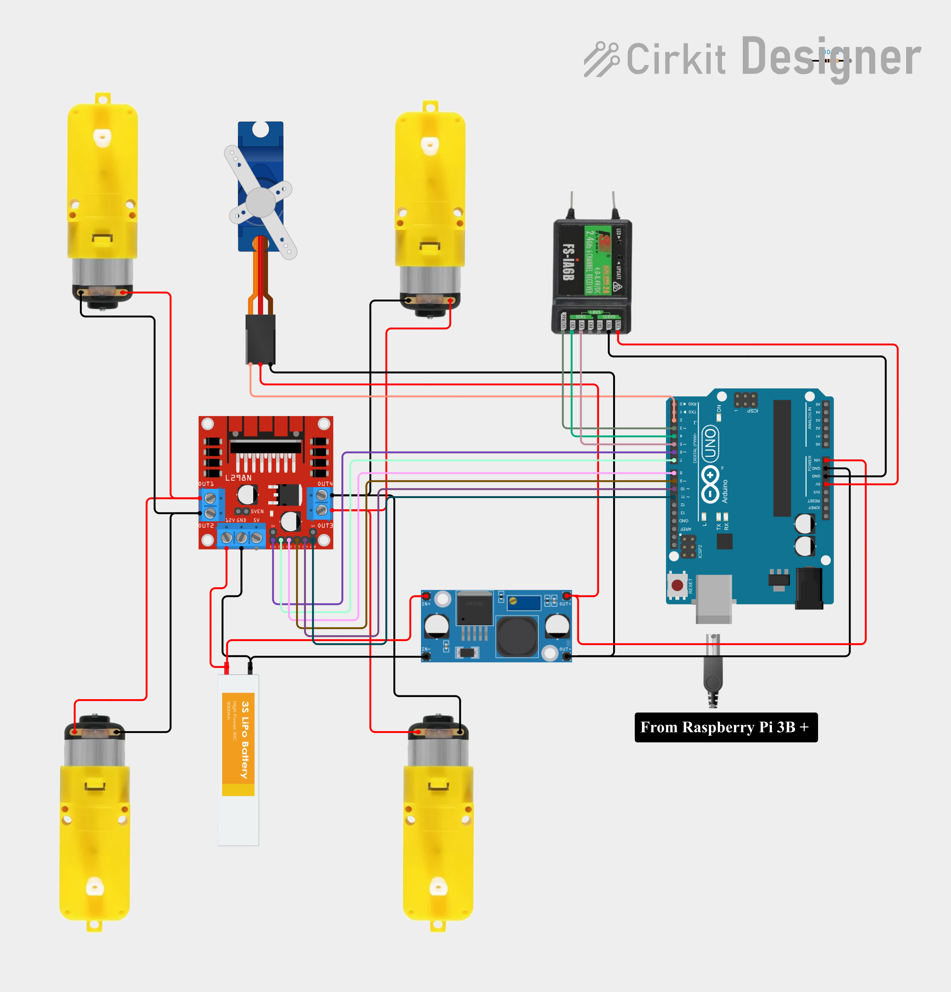
Circuit Diagram
BO Motor
Servo Motor – SG90
BO Motor
CT6B - Receiver
L293D – Motor Driver
LM2596 – Buck Converter
Arduino Uno R3
BO Motor
BO Motor
11.1 Volt 3S Battery

Slide 11
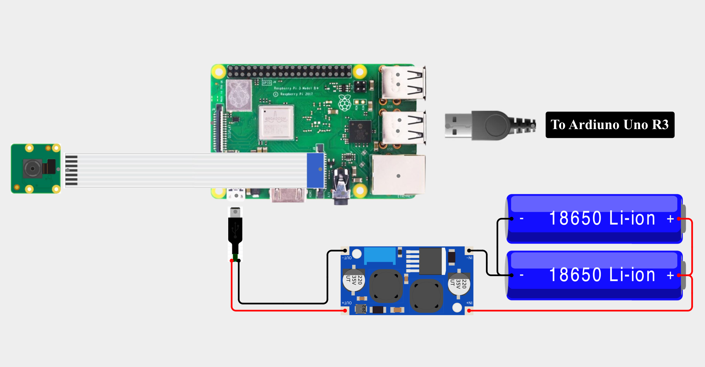
Circuit Diagram
Raspberry Pi 3 B+
Raspberry PI Camera Module V2
18650 – 3.7 Volt Cell
FFC for camera
Xl6009 – Boost Converter

Slide 12
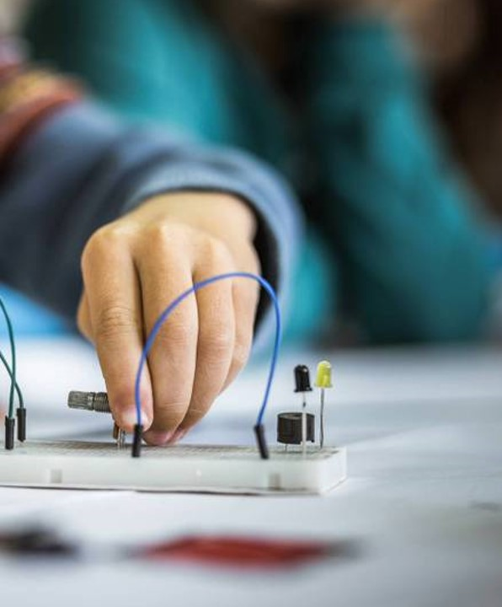
Working/ Workflow :
Startup: All components are powered by the battery
Sensor Activation
Manual or Autonomous Mode:
In Manual Mode, signals from the CT6B receiver control the vehicle via Arduino.
In Autonomous Mode, Raspberry Pi processes sensor data and makes decisions.
Decision Making: Based on Arduino or Raspberry Pi decides direction or stopping.
Motor Control: Motor driver (L293N) executes movement commands from the Arduino.

Slide 13
Working/ Workflow :
Manual Mode
Power On
Sensor Initialization
Mode Selection
Autonomous Mode

Slide 14
Working/ Workflow :
CT6B Receiver
Arduino Control
Motor Driver
Car Movement
Raspberry Pi Logic
Decision Making
Arduino → Motor Driver

Slide 15
Future Advancements
Integration with Computer Vision
Advanced Sensor Fusion
Autonomous Driving Algorithms
Enhanced Communication Protocols
Edge Computing with Jetson Nano
15

Slide 16
Applications
Indoor Navigation for Large Facilities
Autonomous Medical Transport in Hospitals
Smart Disaster Relief Logistics
Autonomous Roadway Maintenance and Inspection
Autonomous Supply Chain and Inventory Management
16

Slide 17
Conclusion
NavDrive successfully demonstrates a cost-effective approach to building an autonomous vehicle using readily available components. By combining the capabilities of Arduino and Raspberry Pi with Camera .the system can navigate and avoid obstacles intelligently. It lays a solid foundation for further development in self-driving technology, offering educational, research, and prototyping value. This project proves that smart mobility solutions can be built without relying on expensive hardware, making innovation more accessible.

Slide 18
Thank you !!!
Any Questions ??
18

